Slide 1


Health Impact Assessment and Health in All Policies Incorporating Health into Planning and Policy Decisions in New Jersey
Planning Healthy Communities Initiative
Bloustein School of Planning and Public Policy
Rutgers University

Slide 2
Planning Healthy Communities Initiative (PHCI)
Rutgers University Partnership
  Edward J. Bloustein School of Planning and Public Policy
  Rutgers Biomedical and Health Sciences
  School of Environmental and Biological Sciences
  School of Social Work
Promotes the integration of health into planning and decision-making about projects and policies.
Notes:
With the emerging practice of Health Impact Assessments being used as a tool to improve the planning and decision-making process, staff at the Edward J. Bloustein School of Planning and Public Policy in collaboration with the Rutgers Biomedical and Health Sciences, at Rutgers recently rolled out a new statewide partnership-based initiative called the New Jersey Health Impact Collaborative.
The Collaborative promotes the integration of health considerations into planning and decision-making at the state, regional and local levels.

Slide 3

Community planning & design
Public Policy
Public Health
Health Admin
About us
Promoting the integration of health into planning and decision-making about projects and policies at the state and local levels.
Community planning & Technical Assistance
Policy Analysis
Training/teaching
Research
Informed dialogue

Slide 4



The Problem
So many daily policy decisions made outside of the health sector have significant health implications that go unrecognized because health is just not on the radar screens of decision makers.
Notes:
And because there are so many of these factors, outside of the healthcare sector, that contribute to an individual’s health, there in lies the problem . . . so many daily policy decisions are made outside of the health sector but have significant health implications that go un recognized because health is just not on the radar screens of decision makers.

Slide 5
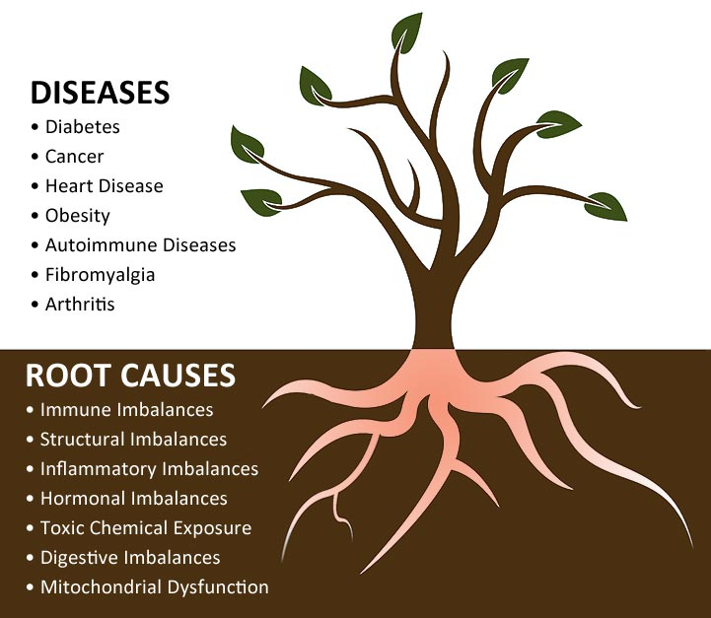

Slide 6
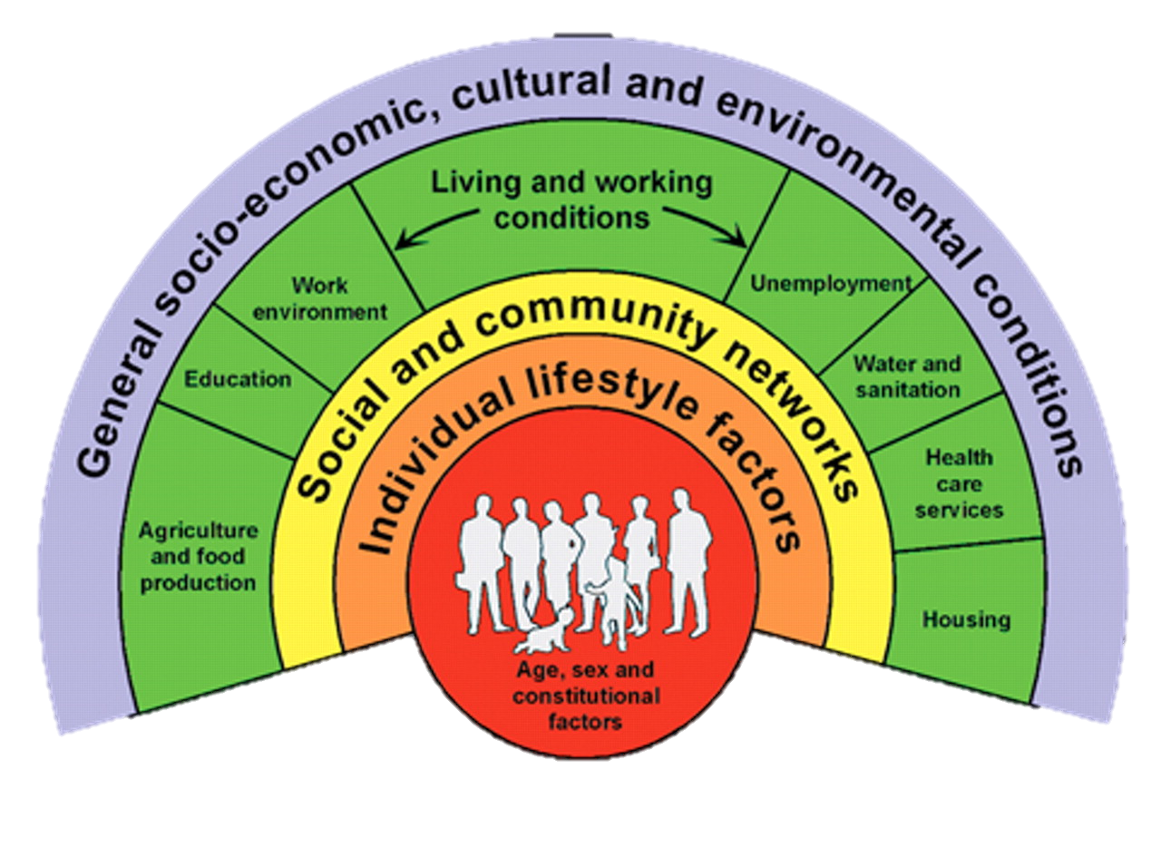
Social Determinants of Health
Source: Dahlgren and Whitehead, 1991
Notes:
Many factors influence health including:
Genetics (red)
Personal behaviors such as smoking, alcohol, diet, exercise and drug use (orange)
3. Societal and political factors including discrimination, social cohesion, education (yellow)
4. Physical environment including access to: housing, food, jobs, a variety of modes of transportation, opportunities for outdoor recreation, affordable and good health care (green)
The Centers for Disease Control defines the “social determinant of health” to be: ‘the circumstances in which people are born, grow up, live, work, and age, as well as the systems put in place to deal with illness. These circumstances are in turn shaped by a wider set of forces: economics, social policies, and politics.”

Slide 7
Housing and Health
Most Americans spend 2/3 of time at home.
Children especially vulnerable.
Evidence that housing is linked to health.
Poor quality housing ➔ fires, infestations, mold, poor ventilation, lead paint, crowding, temperature extremes
Poor housing conditions ➔ asthma, neurological disorders, injuries, mental health
Housing affordability also has implications for health.
Notes:
Public health has long been involved in housing issues. In the 19th century, health officials targeted poor sanitation, crowding, and inadequate ventilation to reduce infectious diseases as well as fire hazards to decrease injuries. Today, public health departments can employ multiple strategies to improve housing, such as developing and enforcing housing guidelines and codes, implementing “Healthy Homes” programs to improve indoor environmental quality, assessing housing conditions, and advocating for healthy, affordable housing. Now is the time for public health to create healthier homes by confronting substandard housing.
Housing is an important determinant of health, and substandard housing is a major public health issue.1 Each year in the United States, 13.5 million nonfatal injuries occur in and around the home,2 2900 people die in house fires,3 and 2 million people make emergency room visits for asthma.4 One million young children in the United States have blood lead levels high enough to adversely affect their intelligence, behavior, and development.5 Two million Americans occupy homes with severe physical problems, and an additional 4.8 million live in homes with moderate problems.6
The public health community has grown increasingly aware of the importance of social determinants of health (including housing) in recent years,7 yet defining the role of public health practitioners in influencing housing conditions has been challenging. Responsibility for social determinants of health is seen as lying primarily outside the scope of public health.
The quality and accessibility of housing is, however, a particularly appropriate area for public health involvement. An evolving body of scientific evidence demonstrates solid relations between housing and health. The public health community is developing, testing, and implementing effective interventions that yield health benefits through improved housing quality. Public health agencies have valuable expertise and resources to contribute to a multisectoral approach to housing concerns. Public health has a long (albeit intermittent) history of involvement in the housing arena, and this involvement is generally accepted by other housing stakeholders (e.g., building departments, community housing advocates). Housingrelated health concerns such as lead exposure and asthma are highly visible.
Living in poorly maintained housing contributes to a variety of health conditions including asthma and other respiratory symptoms, neurological disorders, injury, and mental health problems. Indoor moisture, visible mold, and pests have been associated with development of asthma and other respiratory symptoms. Housing conditions also contribute to accidental injuries and deaths, as the presence of functional smoke alarms and clear means of egress are associated with a lower risk of residential fire morbidity and mortality. Housing conditions that have been linked to the development of chronic disease or chronic disease risk factors include interior and exterior housing deterioration, general poor quality of housing, lack of satisfaction with one’s dwelling, and poor ventilation. There is weaker evidence for the impacts of housing conditions on mental health, as the effects of housing quality are difficult to separate from other housing-related factors, such as instability and disarray (i.e., housing that is cluttered or dark). However, well-maintained housing conditions have been associated with higher psychological wellbeing compared to poorly-maintained housing.
Housing is an important determinant of health, and substandard housing is a major public health issue. Each year in the United States, 13.5 million nonfatal injuries occur in and around the home,2 2900 people die in house fires, and 2 million people make emergency room visits for asthma. One million
young children in the United States have blood lead levels high enough to adversely affect their intelligence, behavior, and development. Two million Americans occupy homes with severe physical problems, and an additional 4.8 million live in homes with moderate problems.
The public health community has grown increasingly aware of the importance of social determinants of health (including housing) in recent years, yet defining the role of public health practitioners in influencing housing conditions has been challenging. Responsibility for social determinants of health is seen as lying primarily outside the scope of public health.
Most Americans spend about 90 percent of their time indoors, and an estimated two-thirds of that time is spent in the home Very young children spend even more time at home and are especially vulnerable to household hazards.
The affordability of housing has clear implications for health. The shortage of affordable housing limits families’ and individuals’ choices about where they live, often relegating lower-income families to substandard housing in unsafe, overcrowded neighborhoods with higher rates of poverty and fewer resources for health promotion (e.g., parks, bike paths, recreation centers and activities). The financial burden of unaffordable housing can prevent families from meeting other basic needs including nutrition and health care, and is particularly significant for low-income families.

Slide 8

Health in all Policies
A strategy that strengthens the link between health and other policies, creating a supportive environment that enables people to lead healthy lives.

Slide 9
Health Impact Assessment is…
…a structured, but flexible, process that
Predicts anticipated health outcomes
Recommends balanced, well-informed decisions
Weigh trade-offs, direct and indirect health impacts
Includes strong engagement of community, business, decision-making body
Courtesy of the Health Impact Project
Notes:
A Health Impact Assessment is a structured, but flexible, process that
Predicts anticipated health outcomes of a proposed decision or project
Translates that information into feasible recommendations for balanced, well-informed decisions that maximize benefits and minimize health risks
Helps weigh trade-offs and understand the direct and indirect health impacts of a project, plan or policy and
Includes strong engagement of community, business and other decision-making bodies
The Sweet Spot – It’s proactive and predictive! It’s meant to inform a proposed policy, program or project currently under active consideration by a decision-making body.
HIA is the framework that translates that data into information and uses it to inform the decision making process.
These community assessments are tools that could be used during the assessment stage of HIA.

Slide 10
Decision Making that Can Benefit from Health Impact Assessment
Policy Decisions (bills by state legislature, city council decision, local governments)
Policy Implementation (how to implement a policy once it is decided)
Projects (siting, permitting, construction, design)
Comprehensive Plans (neighborhood plan, regional growth plans, master planning documents)
Notes:
There are many types of decisions that can benefit from HIA including:
Policy decisions by federal, state, regional, county and local municipal and school governments
Policy implementation once a decision has been made
Projects that are going to be carried out but need input on siting, permitting, design or construction and
Comprehensive plans including municipal master plans and regional growth plans.
Some examples where HIA has been used include:
Building or expanding roads
Creating local school siting policy
Building an out-of-town shopping center
Assessing agricultural policy
Assessing paid sick day policies
Addressing low income energy assistance
Building casinos

Slide 11
Findings/Impact of Housing HIA’s in US
Re-orientation of buildings for healthier airflow
Mental health training for housing
Strengthening and standardizing inspections
Addressing health impacts of displacement
Incorporation of pedestrian-friendly infrastructure and facilities around housing units
Inclusion of health center near housing development
Notes:
Some specifics:
An HIA to examine the potential health impacts on Curry County, Oregon, residentsâ€™ health of upgraded manufactured housing. The HIA found that replacing older homes could significantly improve health by improving indoor air quality, reducing falls, and contributing to positive emotional well-being. A southern Oregon housing developer, NeighborWorks Umpqua, included the HIA findings when applying for a grant to replace 25 manufactured homes in Curry County and was awarded a $450,000 grant from Meyer Memorial Trust.
An HIA looking at public housing upgrades after Hurricane Ike in Galveston was adopted by the Texas General Land Office as a reference document for developers.
The HIA has been included in the City and County of San Francisco's discussions about HOPE SF, which is the city's redevelopment effort of eight public housing sites. In particular, the HIA results were used in discussions around social cohesion, displacement, programs and services, and crime. HOPE SF is currently underway and the San Francisco Department of Public Health continues to be involved in the discussions.

Slide 12

HIA and HiaP
– NJ Examples

Slide 13

PHCI HIA & HiAP Examples
Transportation
  Bloomfield Avenue Complete Corridor Plan (Essex Co.)
  Middlesex Greenway Use and Access Plan
  Rutgers Bike Share
Resiliency & Environment
  Hoboken Stormwater Management Plan and Ordinance
  Mystic Island Voluntary Buyout Scenarios (Little Egg Harbor)
  New Brunswick Public Access to the Raritan
Housing
  Expanding the Definition of Green: Impacts of Green and Active Living Design on Health in Low Income Housing (NY)
Planning
  Planning for Health: Incorporating Health Considerations into Community Master Plans (Trenton)
Notes:
I’m going to tell you about some transportation-related HIAs we have recently completed in NJ. In every HIA it’s always difficult finding local data. One way we address local data is though community input. We combine several methods including on-line surveys, targeted interviews, and various forms of focus groups, roundtables, community meetings and visiting target populations directly, when possible.

Slide 14
Middlesex Greenway HIA –
Positive Impacts
Park benches
Exercise stations at park
Committee to develop signage
Activity loops include Plan Open Space element.
Launch "Greenway Prescription for Health" with local MDs
Used to secure additional grant funding.
Notes:
County is considering placing movable park benches at strategic locations
Considering exercise stations at adjacent park.
Greenway Coalition is considering a special committee to develop robust signage
County will put activity loops that include the Greenway in its master Plan Open Space element.
County is considering launching a "Greenway Prescription for Health" program with local doctors.
Three towns and County Parks will seek formal adoption of the Plan, with HIA, by County Freeholders. (NOT SURE ABOUT THIS YET!)
Woodbridge Twp. used HIA in successful grant proposal for funding to extend Greenway to connect with local park

Slide 15
What difference can HIA make?
Middlesex Greenway: Importance of Elderly needs, and extrapolation of healthcare cost savings from increased fitness
Bloomfield Ave Complete Corridor: Understanding crash reduction and related economic effects
RU Bikeshare: Equity of impacts of program – overlay of socioeconomics with bike infrastructure
Hoboken Green Stormwater Management: Equity of impacts of green infrastructure
Little Egg Harbor Voluntary Buyout: “Lost” and severe impacts of disasters on mental health

Slide 16
Challenges…
Finding good data at the right scale
Lack of a mandate
Silo mentality – Need for transformative thinking
Resources: Finding creative ways to fund HIA and HIAP
…and Opportunities
Builds cross-sector collaboration that can be SUSTAINING
Moves toward Health-in-all-Policies
Calls attention to inequities
Can result in low-cost “quick wins” for health
Notes:
Providing the leadership and resources to ensure that the HIA (and evaluation) is supported and completed
Obtaining and using valid and defensible data (especially at the local level) and analysis methods
Integrating stakeholders who reflect various interests
Accurately depicting an HIA’s impact on a decision-making process and health outcomes
Infuses health into language and thinking
Builds collaboration between disparate groups
Calls attention to inequities
Can result in low-cost “quick wins” for health

Slide 17
PHCI Facilitated Discussions:
State Health Improvement Plan
Listening Sessions with traditional “non-health” sector groups to provide input into SHIP for DOH

Slide 18




What we heard recently
Top-Down & Bottom-Up Strategies
  Not just community-based; State-level policies create the framework!
  Perfection can be the enemy of progress; Capitalize on opportunities now, implement pilots!
Culture & Systematic Policy Change
  Transition away from finger wagging; focus on systems change of “upstream” health factors!
  Health equity fosters a focus on “upstream” factors affecting health.
  Frame health as an economic driver; people pick health & quality of life when choosing where to live!
A new bold leadership role for DOH
  Efforts are underway, but DOH leadership will ensure systematic and sustainable change;
  A new role for DOH: Dot connector; Endorser of good ideas; Convener of thought leaders on wicked problems; Proactive integrator of health into other policy areas.

Slide 19
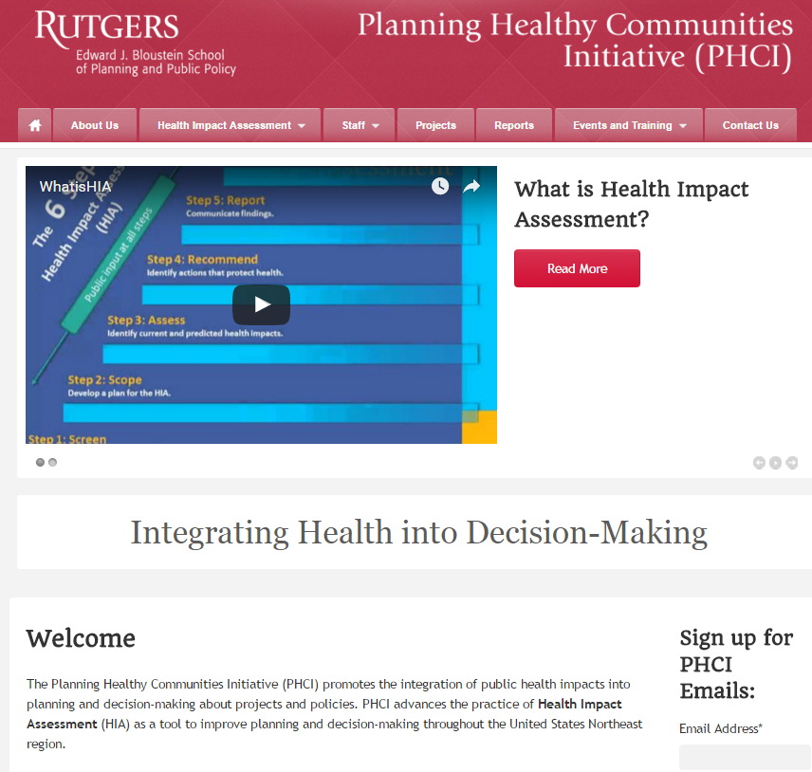
Thank You!
Karen Lowrie
klowrie@rutgers.edu
phci.rutgers.edu
(848) 932-2725
Notes:
Thank you for your interest in Health Impact Assessments. Please visit the New Jersey Health Impact Collaborative at Rutgers University for more information about Health Impact Assessments and to find Health Impact practitioners at njhic.rutgers.edu

